Slide 1
Portfolio Project
FIN 650

Slide 2
Table of contents
01
02
03
04
05
06
Macro Economy & Investment Strategy
Portfolio Composition
Holding Period Performance
Risk and Return Analysis
Individual Stock Performance Analysis
3-Factor model Analysis

Slide 3
Table of contents
07
08
09
10
Stock Ranking & Recommendations
Portfolio Optimization
Efficient Frontier & Tangent Portfolio
Strategies to improve Future Investment

Slide 4

Macro Economy & Investment Strategy
Economic Growth
Inflation Trends
Interest Rates and Monetary Policy
Global Supply Chain Dynamics
Tech Sector Focus
Consumer Discretionary and Luxury
Growth Potential
Notes:
Our portfolio emphasizes the tech sector, with investments in Nvidia and Micron, due to the ongoing digital transformation and increased demand for advanced computing technologies.
Including Best Buy and Louis Vuitton leverages strong consumer spending trends and the demand for high-end goods. Best Buy benefits from electronics demand, while Louis Vuitton capitalizes on the resilient luxury market.
Companies like Uber and Nvidia offer substantial growth potential. Uber is expanding its services beyond ride-sharing, and Nvidia is a leader in AI and gaming technology, promising high future returns.
The U.S. economy has experienced moderate GDP growth, reflecting steady recovery from the pandemic-driven downturn. This growth supports consumer spending and business investments, benefiting companies like Best Buy and Louis Vuitton.
Inflation rates have been rising, driven by supply chain disruptions and increased demand. Higher inflation impacts consumer purchasing power but also incentivizes investment in tech and luxury sectors, where companies like Nvidia and Louis Vuitton can maintain pricing power.
The Federal Reserve's policies aim to balance economic growth with inflation control. Currently low-interest rates support borrowing and investment, favoring growth-oriented tech companies such as Uber, Nvidia, and Micron.
Disruptions in global supply chains have highlighted the importance of technology and innovation in managing logistics and production. Companies like Micron and Nvidia are critical in providing the technology that underpins these improvements, while Louis Vuitton and Best Buy navigate these challenges with strong brand loyalty and supply chain strategies.

Slide 5
Portfolio Composition
Stock | Price($) | Shares | Cost Base | Initial Weight(%)
Best Buy | 76.79 | 250 | 19,197.5 | 19.762%
NVIDIA | 84.53 | 500 | 42265 | 43.5%
Louis Vuitton | 858.45 | 15 | 12876.75 | 13.25%
Uber | 72.26 | 165 | 11922.9 | 12.227
Micron | 108.80 | 100 | 10880 | 11.20%
Total |  |  | 97,142.15 | 100%

Slide 6
Risk Return Analysis
Stocks | Mean Return | Standard Deviation | Sharpe Ratio | Safety First Ratio (Sf Ratio) | Beta (CAPM) | Adj R Square | Risk Assessment
Micron | 0.00015129 | 0.02661663 | 0.00655 | 0.00157 | 1.43687 | 0.5677 | More Risky (beta > 1)
NVIDIA | 0.0016214 | 0.0356571 | 0.04611 | 0.04611 | 1.59204 | 0.3945 | More Risky (beta > 1)
Uber | 0.0002530 | 0.0212358 | 0.01299 | 0.00676 | 2.17626 | 0.6941 | More Risky (beta > 1)
Louis Vuitton | 0.0000723 | 0.0234089 | -0.00211 | -0.00777 | 0.99345 | 0.3986 | Less Risky (beta < 1)

Slide 7
NVIDIA emerges with the highest Sharpe ratio (0.0461), indicating superior risk-adjusted returns among the analyzed stocks. It also exhibits higher volatility compared to the market average (beta > 1), making it appealing for investors seeking potentially higher returns despite increased risk.
Uber follows closely with a positive Sharpe ratio (0.0130) and a significant beta (2.17626), suggesting it is also volatile but offers competitive risk-adjusted returns.
Micron shows comparatively lower risk-adjusted returns with a Sharpe ratio of 0.0065 and a beta exceeding 1, indicating it is more volatile than the market.
Louis Vuitton displays a negative Sharpe ratio (-0.0021) and a beta less than 1, signifying lower risk and poorer risk-adjusted returns
Conclusion: NVIDIA and Uber are recommended for investors seeking higher returns relative to risk, while Micron offers a moderate risk-return profile. Louis Vuitton may appeal to conservative investors prioritizing lower risk over potential returns. Investors should align their choices with their risk tolerance and investment objectives.

Slide 8
Individual Stock Performance Analysis
Stock | Mean Return | Standard Deviation | Sharpe Ratio | Beta (CAPM) | Intercept (p-value) | Coefficient of X1 (RM-RF) | Adj R Square
NVIDIA | 0.0016214 | 0.0356571 | 0.0461 | 1.59204 | 0.00067248 (0.7059) | 1.59204 (p < .0001) | 0.3945
Analysis: NVIDIA demonstrates the highest Sharpe ratio among the stocks analyzed, indicating strong risk-adjusted returns. Its beta suggests higher volatility compared to the market average.
Stock | Mean Return | Standard Deviation | Sharpe Ratio | Beta (CAPM) | Intercept (p-value) | Coefficient of X1 (RM-RF) | Adj R Square
Uber | 0.0002530 | 0.0212358 | 0.0130 | 2.17626 | 0.00067248 (0.3816) | 2.17626 (p < .0001) | 0.6941
Analysis: Uber shows a positive Sharpe ratio and the highest beta among the stocks, indicating higher volatility and competitive risk-adjusted returns.

Slide 9
Stock | Mean Return | Standard Deviation | Sharpe Ratio | Beta (CAPM) | Intercept (p-value) | Coefficient of X1 (RM-RF) | Adj R Square
Micron | 0.00015129 | 0.02661663 | 0.0065 | 1.43687 | -0.00049324 (0.6637) | 1.43687 (p < .0001) | 0.5677
Analysis: Micron exhibits lower risk-adjusted returns compared to NVIDIA and Uber, with a moderate beta indicating higher volatility than the market.
Stock | Mean Return | Standard Deviation | Sharpe Ratio | Beta (CAPM) | Intercept (p-value) | Coefficient of X1 (RM-RF) | Adj R Square
Louis Vuitton | 0.0000723 | 0.0234089 | -0.0021 | 0.99345 | 0.00090172 (0.4136) | 0.99345 (p < .0001) | 0.3986
Analysis: Negative Sharpe ratio, beta less than 1, indicating lower risk and poorer risk-adjusted returns.
Conclusion
NVIDIA and Uber offer competitive risk-adjusted returns with higher volatility, suitable for investors comfortable with market exposure.
Micron presents moderate risk-return characteristics in the tech sector.
Louis Vuitton provides lower risk but with reduced potential returns, appealing to conservative investors prioritizing stability.

Slide 10
Holding Period Performance
Below are tables summarizing the key metrics and the weekly performance breakdown for your portfolio and the S&P 500 from April 12 to May 31.
Key Metrics
METRICS | VALUES
Initial Portfolio Market Value | $100,000.00
Final Portfolio Market Value | $113,005.80
S&P 500 Initial Level | 5,123.41
S&P 500 Final Level | 5,277.51

Slide 11
Weekly Performance Breakdown
WEEK | Date Range | Portfolio Return | S&P 500 Return | Portfolio Market Value | S&P 500 Market Value
Week 1 | 4/12 - 4/19 | -5.58% | -3.05% | $94,420.60 | 4,967.23
Week 2 | 4/19 - 4/26 | 6.19% | 2.67% | $100,263.56 | 5,099.96
Week 3 | 4/26 - 5/3 | 0.11% | 0.55% | $100,376.30 | 5,127.79
Week 4 | 5/3 - 5/10 | 0.89% | 1.85% | $101,265.20 | 5,222.68
Week 5 | 5/10 - 5/17 | 1.33% | 1.54% | $102,609.85 | 5,303.27
Week 6 | 5/17 - 5/24 | 7.06% | 0.03% | $109,856.65 | 5,304.72
Week 7 | 5/24 - 5/31 | 2.87% | -0.51% | $113,005.80 | 5,277.51
Total | 4/12 - 5/31 | 13.01% | 3.01%
Total Holding Period Return
Portfolio Holding Period Return (4/12 - 5/31): 13.01%
S&P 500 Holding Period Return (4/12 - 5/31): 3.01%
Summary: Over the holding period, portfolio substantially outperformed the S&P 500, achieving a return of 13.01% compared to the S&P 500's 3.01%.

Slide 12
Analysis
Initial & final values
2. Weekly Trends
The portfolio started at $100,000 and grew to $113,005.80, marking a substantial increase over the holding period.
The S&P 500 index rose from 5,123.41 to 5,277.51, indicating a moderate market improvement
The portfolio started at $100,000 and grew to $113,005.80, marking a substantial increase over the holding period.
The S&P 500 index rose from 5,123.41 to 5,277.51, indicating a moderate market improvement
The portfolio faced initial setbacks but demonstrated resilience with consistent gains from week two onwards.
Particularly notable was the performance in weeks six and seven, where the portfolio's returns significantly outpaced the S&P 500.
3. Performance Comparison
Overall, the portfolio's strategies and asset allocations resulted in superior performance compared to the market index.
The week-by-week analysis shows that despite market volatility, the portfolio managed to capture upside gains effectively

Slide 13
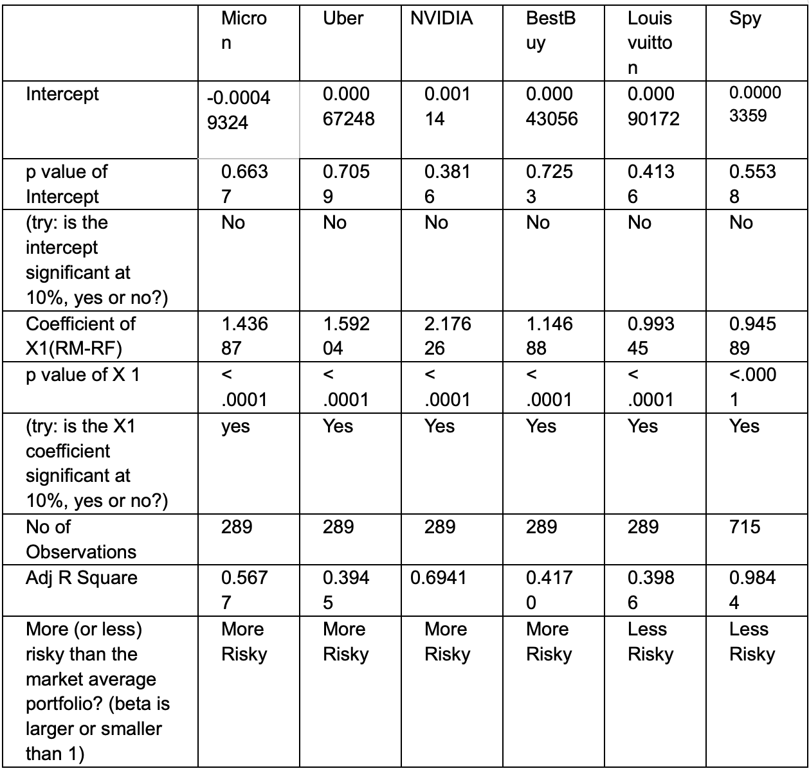
Three Factor Model

Slide 14
Stock Rankings
Stock | Aggressive | Moderate | Conservative
Uber | 2 | 3 | 5
Micron | 3 | 3 | 2
NVIDIA | 1 | 2 | 5
Louis Vuitton | 5 | 4 | 1
Best Buy | 4 | 5 | 3

Slide 15
Preferable stock
Most Preferable stock : NVIDIA
Nvidia (NVDA) is the most preferable stock because its models exhibit high R-Square values (69.51% for CAPM and 72.75% for FF 3-Factor), indicating strong explanatory power. Additionally, the market risk premium is highly significant, demonstrating a robust relationship with market returns, and the significant negative HML factor highlights a preference for growth stocks.
Least Preferable stock : Uber
Uber is the least preferable stock because it exhibits relatively lower R-Square values (39.66% for CAPM and 51.13% for FF 3-Factor), indicating weaker explanatory power of the models. Additionally, its high market risk premium suggests higher volatility, making it a riskier investment.

Slide 16
Portfolio optimization
Global min Variance
The global minimum variance portfolio, also known as the minimum variance portfolio, is the portfolio that achieves the lowest possible variance among all potential portfolios, regardless of the expected return. This portfolio is optimized to minimize risk, providing the most efficient balance of assets to achieve the least volatility.
Minimal variance
Uber | w1 | 0.3808294
Micron | w2 | -0.05080908
Nvidia | w3 | 0.054123958
Louis Vuitton | w4 | 0.615855718
Constraint 2 |  | 0
Min. Var. Portfolio STD |  | 0.013647177
Min. Var. Portfolio Return |  | 0.001620424

Slide 17
Optimized Portfolio(Sharpe ratio)
Optimized sharpe ratio | 0.182752066
Tangent Portfolio STD | 0.022742204
Tangent Portfolio Return | 0.004279985
Constraint 2 | 0.615855718
The optimized portfolio maximizes the Sharpe ratio, combining assets to achieve the highest possible return for a given level of risk. It is represented by the point on the Capital Market Line (CML) where the line is tangent to the efficient frontier

Slide 18
Tangent Returns
Tangent returns are the expected returns of the tangency portfolio, which optimizes the Sharpe ratio by blending a risk-free asset with a market portfolio. This portfolio achieves the highest return for a specific level of risk and is depicted by the tangency point on the Capital Market Line (CML).
Graph Data
Target Return | 0.0005 | 0.0001 | 0.0015 | 0.002 | 0.0025 | 0.003
Optimal Portfolio STD | 0.15652012 | 0.017258466 | 0.1367202 | 0.013891964 | 0.149144579 | 0.016592
Efficient Frontier | 0.0020505857 | -0.000130231 | 0.007530421 | 0.010266368 | 0.013002315 | 0.015738

Slide 19
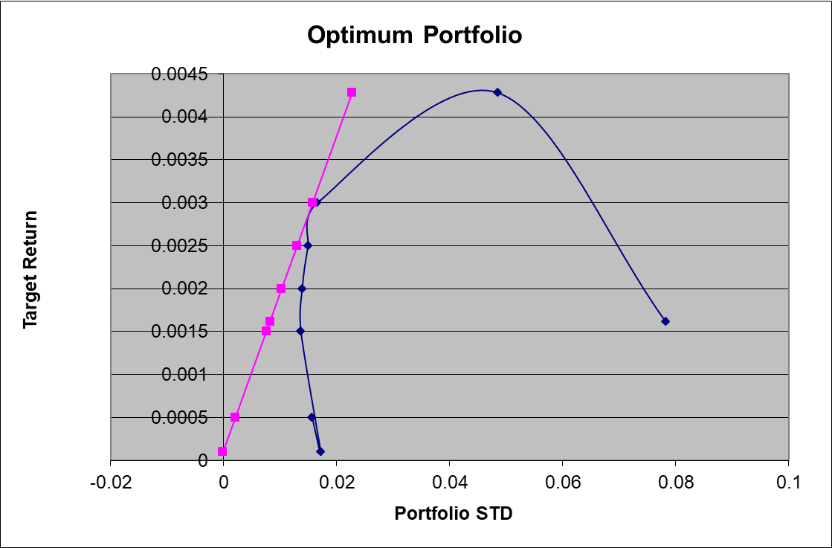
Efficient Frontier and Tangent Portfolio
Efficient frontier represents the set of optimal portfolios that offer the highest expected return for a defined level of risk.
The point where the pink line touches the blue curve is the tangent (or market) portfolio, which has the highest Sharpe ratio, representing the best risk-adjusted return.
Based on the tangent point, the optimal portfolio's composition can be determined. This portfolio offers the best return for the given level of risk.
Notes:
Efficient Frontier: Demonstrates how diversification helps in achieving optimal portfolios.
Tangent Portfolio: Represents the best risk-adjusted return, guiding our investment strategy.

Slide 20
Reflection
Diversification Benefits: Mitigated risks and enhanced returns by investing across various sectors.
Risk-Return Trade-Off: Balanced risk and return effectively through the efficient frontier and CML.
Market Volatility: Highlighted the need for ongoing monitoring due to the impact of market fluctuations.
Data-Driven Decisions: Emphasized the importance of using financial metrics and models for informed investments.

